Slide 1

Lite Loans New-to-bank,
Credit Risk Application Probability of Default Scorecard

Slide 2
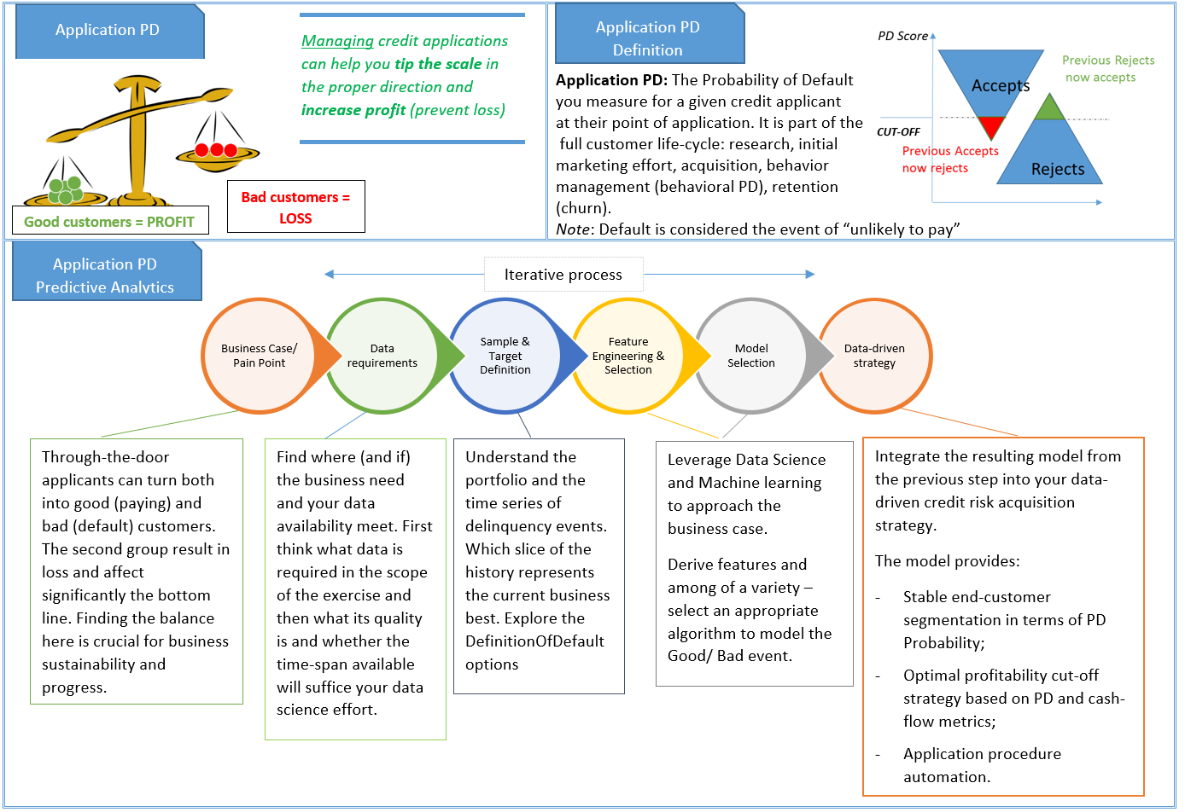
Generic application PD process flow

Slide 3
Business Case

Slide 4
Business & Project Goal
Business Goal: Optimize the application point of through-the-cycle strategy for customer acquisition. The approach should be:
Reliable
Transparent
Profit & Growth-oriented
Project Goal: Develop credit risk application probability of default scoring model that focuses on:
Lite Loans New-to-bank segment
Meeting business goals
Taking into account the scoring model (and Provenir) role in relationship to the overall acquisition funnel
Build a holistic risk profile of our customers
*Frauds are excluded from Credit Risk Probability of Default scoring models since they are operational risk

Slide 5
Data

Slide 6

Data Extraction
Data:
Was spooled directly from Mambu
For the period of January 2021 – March 2022
Multiple times to account for some of the NULL values being tackled retrospectively
Types of data acquired:
Application data – socio-demographic, product, decisioning, etc.
Behavioural data – Max Days Past Due (DPD)
Transactions data – Loan Amount, Repayments( Interest paid, Penalty Paid, Fees Paid , Principal paid)
Salary Service Data: Bank Statement Extracted Variables
Exclusions:
Early settled customers
Accounts with Incomplete Bank Statements (less than 3 months)
Accounts with operational glitches such as expired cards, Remita not activated, incorrectly tokenized cards, e.t.c
Returning customers

Slide 7
Sample & Target Definition

Slide 8
Sample & Target Definition (1/2)
May – December 2021 was used as development data
Capturing a significant amount of defaults
Smoothing seasonality effect
Policy decline rates has reduced over 2021
OOT (Out-of-time) validation window for Jan-Feb 2022

Slide 9
Sample & Target Definition (2/2)
Definition of Default (DoD)
MAX DPD >= 61 was selected
Development
Provides stable default rate over the development window
Default rate received with the DoD is close to the write-off rate (considered to be the proxy)
Cure rate is below 10%
Development

Slide 10
Feature Engineering

Slide 11
Derived Variables
Salary Service Variables
Demographic Variables
Variables | Derivation
r_avNumCrM_avNumDe_M' | Ratio of average number of credit and debit across months
r_avNumCrW_avNumDe_W | Ratio of average number of credit and debit accross weeks
avCreditAmountMn | Average Credit Amount
avDebitAmount | Average Debit Amount
r_CreditLM_avDebitLM | Ratio of last submitted full month credit and debit
avLoanRep_L3M | Average loan repayment in the last 3 full months
r_DebitLM_DebitL3M | Debit ratio of last full month and last third month
HighestSingleDebitL3M | Highest Single Debit in the last full 3 months
r_avCredit_avDebit | Ratio of average credit and average debit
age_DebitAmount | Age and Debit Amount
Age_HSD_L3M | Age and Highest Single Debit in the last 3 months
AddressLGA_r_avCredit_avDebit | Address and Ratio of average credit and average debit
AddressLGA_r_CrLM_avDeLM | Address and Ratio of last submitted full month credit and debit
Variables | Derivation
EmployerLGA_Age | Concatenation of Customer’s EmployerLGA and Age
AddressLGA_Age | RConcatenation of Customer’s AddressLGA and Age
Income_Gender | Concatenation of Customer’s Income and Gender
TimeatAddress_AddresLGA | Concatenation of Customer’s Time at Address and AddresLGA
TimeinEmployment_EmployerLGA | Concatenation of Customer’s EmployerLGA and Time in Employement
Income_Gender | Concatenation of Customer’s Income and Gender
Residential_Income | Concatenation of Customer’s Residential Status and Income
MaritalStatus_Residential | Concatenation of Customer’s Marital Status and Residential Status

Slide 12
Feature Selection

Slide 13
Univariate Characteristic Analysis
The Information Value analysis tells us how well does a single variable discriminate against the target
The Criteria used in selecting features are:
IV between 0.02 and 0.5
PSI < 0.2
VIF <10
The population stability index (PSI) is a statistic that measures how much a variable has shifted over time, and is used to monitor applicability of a statistical model to the current population.
Variance inflation factor (VIF) is a measure of the amount of multicollinearity in a set of multiple variables

Slide 14
Model Results

Slide 15
Modelling approach and results
Target | Default = Max DPD 61+
Statistical learning method | Classification
Algorithm used | Logistic regression
Coarse classing method | WOE (Weight-of-evidence)
Development sample window | May-Dec 2021
Development sample validation | Train/Test split (70/30)
Out-of-time validation | Jan-Feb 2022
Recent sample validation (PSI) | Jan-Mar 2022
Reject inference | N/A
Variables | Coef. | Std.Err. | z | P>|z| | [0.025 | 0.975]
averageCredit
Closing_balance | 0.5405 | 0.1494 | 3.6176 | 0.0003 | 0.2477 | 0.8333
avDebitAmount | 0.6829 | 0.1139 | 5.9974 | 0 | 0.4597 | 0.9061
minimumCredit | 0.6638 | 0.1463 | 4.5366 | 0 | 0.377 | 0.9506
Tv_freq_4 | 0.6288 | 0.1422 | 4.4211 | 0 | 0.3501 | 0.9076
EmployerLGA_Age | 0.5595 | 0.1057 | 5.2943 | 0 | 0.3524 | 0.7666
total_cash_flow | 0.4139 | 0.1372 | 3.0158 | 0.0026 | 0.1449 | 0.6829
monthly_cash_flow_1 | 0.4986 | 0.135 | 3.6941 | 0.0002 | 0.2341 | 0.7632
r_avNumCrW_avNumDe_W | 0.6127 | 0.1547 | 3.9601 | 0.0001 | 0.3095 | 0.916
Cre_gr_eq_2 | 1.2656 | 0.2019 | 6.2689 | 0 | 0.8699 | 1.6613
Day_Diff_Debit | 0.9867 | 0.1608 | 6.1363 | 0 | 0.6715 | 1.3018
r_avCredit_avDebit | 0.809 | 0.2081 | 3.8878 | 0.0001 | 0.4012 | 1.2169
Sample Deep Dive | Total Samples | No.Goods | No.Bads | % Goods | % Bads | Gini
Train: | 4050 | 2025 | 2025 | 50% | 50% | 41%
Test: | 1207 | 906 | 299 | 75% | 25% | 35%
OOT: | 876 | 625 | 251 | 71% | 29% | 32%
5-fold Cross validation | 4016 | 2931 | 1085 | 73% | 27% | 37.8%
Key take-aways :
Decent model performance and good validation between train, test and Validation sample
Total of 12 variables – BankStatement and Request data:
11 BankStatement variables including cross-vars
1 Socio-demographic cross-variable – Age vs Employer LGA
* See in Appendix the list of the original Salary Service vars used

Slide 16
Data-Driven Strategy

Slide 17


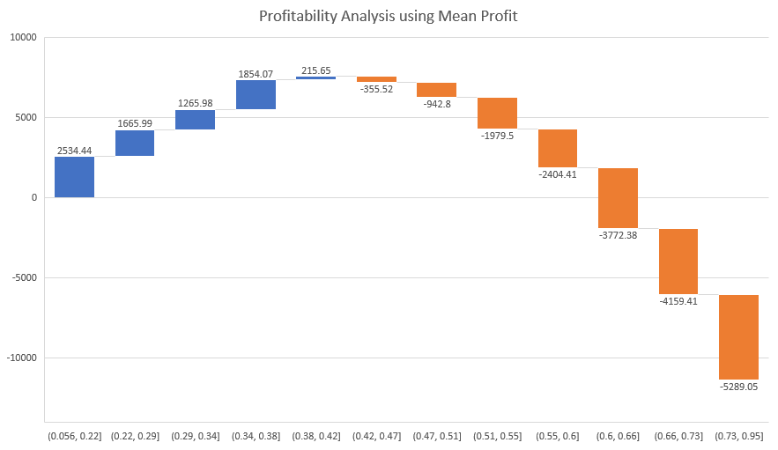
Strategy cut-off – overall profitability approach (1/2)
Profit calculation approach:
$$Profit(without Costs)=repayment −disbursement$$
$$Profit\left(with Costs\right)=repayment −\left(VC\right)∗disbursement$$
Where VC =8.4%
$$Mean Profit\left(Loss\right)=\frac{Profit}{Total}$$
Please see Appendix for more detailed results

Slide 18
Strategy cut-off – overall profitability approach (2/2)
Cut-off proposal – reject all customers with PD > 66%. This would have resulted in:
17% less disbursements last year
25% less Provenir Approved for Q1 this year
Reasoning and further notes:
At 66 % we are close to break even on the product, including variable-costs
DS advises that we maintain a portfolio of <25% default rate (60+ DPD)
DS advises that we maintain a portfolio of <25% FPD 30 rate
The approach proposed is NOT considered conservative from DS point-of-view
*See appendix for further information

Slide 19
Customer Profiling

Slide 20



Customer profiling according to the scoring model
Best Performing Profiles ☺
Average credit greater than 9000, minimum credit of 200, total cash flow greater than 1000, monthly cash flow of 5000 and above, Day diff Debit between 0 and 2 days
Worst Performing Profiles ☹
Average credit of less than 4000, average debit amount of less than 2500, minimum credit of less than 30, monthly cash flow between -70 and 708, Day diff Debit between 4 and 13 days

Slide 21
Summary

Slide 22
Summary & Conclusions
This model will address the Digital Channel requests for LiteLoans or (InstaLoan product that resembles our Lite Loans) for the NTB segment.
Model Gini* of 38% - this is better than the Gini for our PL NTB model (Gini of 33%)
Decision science’s proposal is to
Deploy the model outlined in this presentation
Monitor portfolio overall Bad Rate (61+ DPD) to be less then 25%
Monitor portfolio FPD 30 to be less than 25%
Best and worst profiles to be communicated to marketing for target campaigns improvements
Optimize cross/ up-sale & UnitEconomis – this might turn out to be a solid NTB product allowing almost everyone to pass through
*The Gini coefficient is a metric that indicates the model's discriminatory power, namely, the effectiveness of the model in differentiating between “bad” borrowers, who will default in the future, and “good” borrowers, who won't default in the future. A Gini of 100% is a perfect score – the ability to fully separate defaults from good customers.

Slide 23
Thank You!

Slide 24
APPENDIX

Slide 25
Cut-off strategy table
PD_Binned | Bad | Good | Total | Bad.Rates | Cumulative Bad Rate | FPD30 | FPD30 CumRate | GBOdds | Disbursements | Variable.Cost | Profit/Loss | Profit(Without Cost) | Mean.Profit | Mean.Profit(Without Cost) | Mean Cum Profit | Mean Cum Profit Without Costs
(0.056, 0.22] | 32 | 303 | 335 | 10% | 10% | 35 | 10% | 9.47 | ₦ 5,821,900 | ₦ 489,040 | ₦ 849,036 | ₦ 1,338,075 | ₦ 2,534 | ₦ 3,994 | ₦ 2,534 | ₦ 3,994
(0.22, 0.29] | 38 | 297 | 335 | 11% | 10% | 40 | 11% | 7.82 | ₦ 5,430,200 | ₦ 456,137 | ₦ 558,107 | ₦ 1,014,244 | ₦ 1,666 | ₦ 3,028 | ₦ 2,100 | ₦ 3,511
(0.29, 0.34] | 58 | 276 | 334 | 17% | 13% | 60 | 13% | 4.76 | ₦ 5,332,600 | ₦ 447,938 | ₦ 422,839 | ₦ 870,777 | ₦ 1,266 | ₦ 2,607 | ₦ 1,823 | ₦ 3,210
(0.34, 0.38] | 47 | 288 | 335 | 14% | 13% | 46 | 14% | 6.13 | ₦ 5,379,400 | ₦ 451,870 | ₦ 621,114 | ₦ 1,072,984 | ₦ 1,854 | ₦ 3,203 | ₦ 1,831 | ₦ 3,208
(0.38, 0.42] | 66 | 268 | 334 | 20% | 14% | 71 | 15% | 4.06 | ₦ 5,339,300 | ₦ 448,501 | ₦ 72,028 | ₦ 520,529 | ₦ 216 | ₦ 1,558 | ₦ 1,508 | ₦ 2,879
(0.42, 0.47] | 72 | 263 | 335 | 21% | 16% | 70 | 16% | 3.65 | ₦ 5,030,800 | ₦ 422,587 | -₦ 119,099 | ₦ 303,488 | -₦ 356 | ₦ 906 | ₦ 1,197 | ₦ 2,550
(0.47, 0.51] | 91 | 244 | 335 | 27% | 17% | 90 | 18% | 2.68 | ₦ 4,975,900 | ₦ 417,976 | -₦ 315,838 | ₦ 102,138 | -₦ 943 | ₦ 305 | ₦ 891 | ₦ 2,229
(0.51, 0.55] | 102 | 232 | 334 | 31% | 19% | 100 | 19% | 2.27 | ₦ 4,794,600 | ₦ 402,746 | -₦ 661,153 | -₦ 258,406 | -₦ 1,979 | -₦ 774 | ₦ 533 | ₦ 1,854
(0.55, 0.6] | 107 | 228 | 335 | 32% | 20% | 107 | 21% | 2.13 | ₦ 4,791,100 | ₦ 402,452 | -₦ 805,477 | -₦ 403,024 | -₦ 2,404 | -₦ 1,203 | ₦ 206 | ₦ 1,514
(0.6, 0.66] | 146 | 188 | 334 | 44% | 23% | 139 | 23% | 1.29 | ₦ 4,641,300 | ₦ 389,869 | -₦ 1,259,976 | -₦ 870,106 | -₦ 3,772 | -₦ 2,605 | -₦ 191 | ₦ 1,103
(0.66, 0.73] | 148 | 187 | 335 | 44% | 25% | 145 | 25% | 1.26 | ₦ 4,550,800 | ₦ 382,267 | -₦ 1,393,403 | -₦ 1,011,135 | -₦ 4,159 | -₦ 3,018 | -₦ 552 | ₦ 728
(0.73, 0.95] | 178 | 157 | 335 | 53% | 27% | 174 | 27% | 0.88 | ₦ 4,215,600 | ₦ 354,110 | -₦ 1,771,833 | -₦ 1,417,722 | -₦ 5,289 | -₦ 4,232 | -₦ 947 | ₦ 314

Slide 26
Exclusions details
Incomplete BS evolution 2021 (total_debit_4 AND total_credit_4 ARE Null)
Disbmonth | count of IDs with incomplete BS | Disbursed Pop | % with Incomplete BS
Mar-21 | 161 | 690 | 23.33%
Apr-21 | 195 | 665 | 29.32%
May-21 | 193 | 681 | 28.34%
Jun-21 | 176 | 639 | 27.54%
Jul-21 | 180 | 447 | 40.27%
Aug-21 | 102 | 768 | 13.28%
Sep-21 | 29 | 265 | 10.94%
Oct-21 | 37 | 712 | 5.20%
Nov-21 | 40 | 718 | 5.57%
Dec-21 | 65 | 709 | 9.17%

Slide 27
Features
Original Salary Service “Extractor” variables used in the model
Existence of these features in Oktopus has been validated
averageCredit
Closing_balance
AvgNumDebitMn
AvgDebitMn
minimumCredit
total_cash_flow
monthly_cash_flow_1
AvgNumCreditWk
AvgNumDebitWk
Cre_gr_eq_2
Day_Diff_Debit
averageDebit

